Slide 1

MAPA Compliance Forum
CMS/MAPA “Getting to Know the Plans”
December 11, 2019

Slide 2

WHO ARE WE?
Founders: Gail McGrath and David Main
Date: 2016
Name: Medicare Advantage Plan Alliance
(MAPA) DBA as MAPA Compliance Forum
Structure: Plan driven 501(c)(6) non-profit
organization governed by a board of
directors and officers and funded by
membership dues.
Purpose: To advance regulatory
compliance in a collaborative manner
between CMS and member MA Plans.

Slide 3




MA plans have had difficulty understanding
and complying with CMS rules and
regulations since the inception of Part C.
MA plans have had difficulty in applying rules
and regulations to the business model of a
health plan.
 |  | WHY MAPA?
Most regulators have not worked in a
health plan and have limited experience in
how health plans operate.
MAPA was formed to close the knowledge
gap between MA plans and regulators, and
to collaborate constructively on achieving
compliance.

Slide 4

MAPA: Member Plans
by State
Small, medium, and
large – each
member has equal
vote.
Size of MAPA member
plans
MAPA member
plans are in every
state, DC and US
territories
Over 13 million
beneficiaries out of
the 22.2 million
currently in MA plans.

Slide 5

WHAT WE DO: How MAPA Works With CMS
Plans identify rules and regulations that cause compliance challenges.
Plans work together to develop solutions that would maintain regulators’ oversight but make it more
feasible for plans to comply.
Plans meet with CMS either in person or remotely to discuss the challenging areas and suggest
solutions.
CMS may or may not adopt Plans’ suggested solutions but better understand plans’ efforts.
To date, Plans have met with CMS on a number of topics such as audits, appeals and grievances,
CTMs, and criteria for Star ratings.
Attendance of CMS at meetings is quite high, as is their preparation and participation, and they have
often conveyed how helpful the dialogues have been.

Slide 6


Building a Strong Foundation – Basic Plan Requirements
Plan Approval – Maintaining Operations
Basic Plan Offering – (MA, MA/PD, or PDP)
Licensing – state (s)
Plan Design (HMO, PPO, SNP)
Value Added Services
Bid Development, submission, & approval
Plan Operations – meeting standards
Member Services/Call Center
Sales (employed or external agents)
Enrollment (LIS, MSP)
Premium Billing (LEP, IRMAA)
Appeals & Grievances
Claims
Materials – letters, advertising, directories
Meeting Basic Plan
Requirements
Vendor and oversight
Reporting
Audits
Compliance
Building a Strong Infrastructure = Quality

Slide 7

Regulatory Audits Agenda
> The MA Program is a shared responsibility and accountability
> So you really want to know what we think about CMS regulatory audits?
> What well-defined, transparent regulatory audits accomplish
> Panel discussion: Our recommendations to improve the effectiveness
and value of regulatory audits

Slide 8

Medicare Advantage is a Shared Responsibility and Accountability
•• We read the newspapers and industry reports and are well aware of the intense
scrutiny and focus upon the MA Program.
•• We regard the MA Program as an excellent model for responding to Medicare
beneficiary preferences, introducing new benefits, and fostering innovations.
•• We are fully committed to seeing the MA Program succeed in delivering value-
based care that achieves quality outcomes with high beneficiary satisfaction.
“Medicare is important for Advantage an component of choice Medicare-eligible
Americans...The intrinsic value of MA is that people enrolled in the program
receive coordinated care, thus improving their chances of staying healthy or from their illnesses.”
recovering
Former Secretary of HHS (2009–2014) Kathleen Sebelius

Slide 9

What we really do think about Regulatory Audits
+They are an opportunity for MA plans to show how well we provide Medicare
beneficiaries access to medical services and medications, and afford them the
rights and protections set by regulations.
+They are an important way to demonstrate to CMS, the OIG, Congress, and the
public at-large the value and strong outcomes achieved by MA plans.
+They are an essential component in building trust in the MA Program and its
participating plans, and protecting the integrity of this popular, growing program.

Slide 10
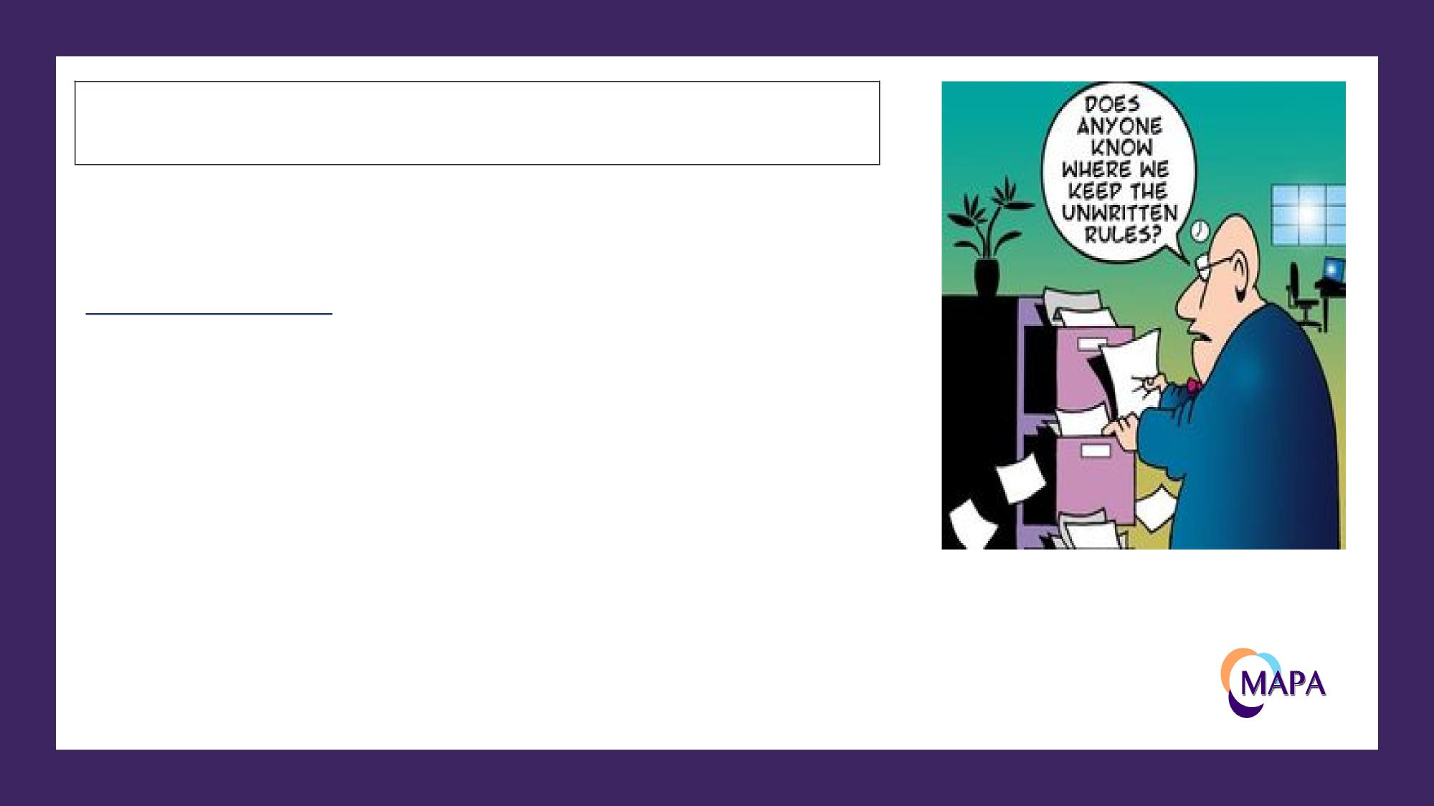
Recommendation #4 – Regulatory audits should not be used to
establish new regulatory standards.
Panel Discussion:
Ø Describe a CMS regulatory audit experience in
which your plan was held to a regulatory
standard that went beyond the then-established
written standard.

